Slide 1

Bank loan of customers
In this project we are showing customers yearly loan amount , customers verification status is verified or not. And it also shows customers loan status according to customers last credit pull, its show last payment date status according to home ownership, it shows revol balance according to customers grade and sub grade wise. This all about our project.
Group – 2
Chaitali Sure
Pravin Patil
Shreyash Patil
Rajat Upadhyay
Vaishali Timase

Slide 2
INDEX
Year wise loan amount Status
Grade and sub grade wise revol_bal
Total Payment for Verified Status Vs Total Payment for Non Verified Status
State wise and last_credit_pull_d wise loan status
Home ownership Vs last payment date stats

Slide 3
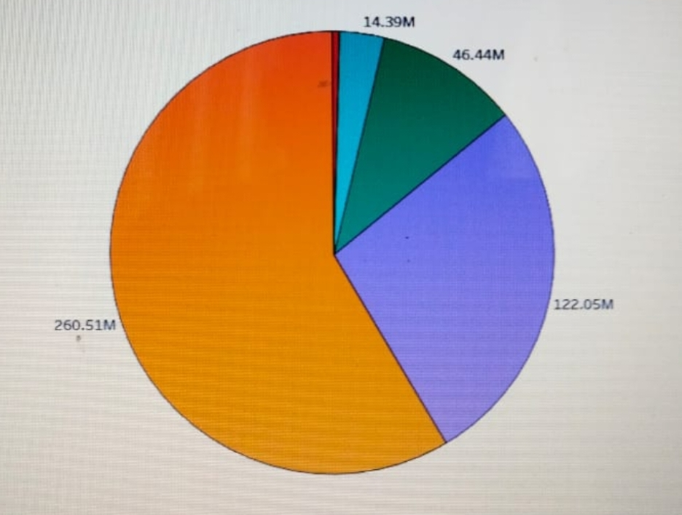
KPI 1 - Year wise loan amount Stats
Total percentage increased is 99.14% by comparing loan taken in year 2007 and 2011
Total installment for term 3 years is higher compared to total installment for term 5 years
Comparing funded amount taken in year 2007 and 2011 increased by 99.15%.

Slide 4
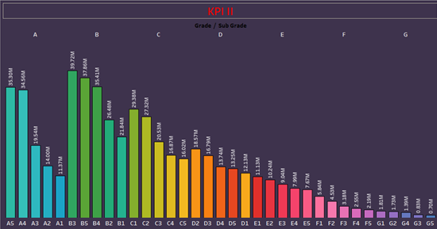
KPI 2 - Grade and sub grade wise revol_bal
It shows sum of grade and subgrade
Graph shows comparison between grades
It shows grade and sub grade wise minimum and maximum
In this Grade B has highest revol_bal as compare to other grade.
By using grading system, Bank accurately evaluate credit risk or probability of loss due to a borrower’s failure to make payments.
It establishes a cut off point to help lenders decides how much risk they are willing to take on.

Slide 5
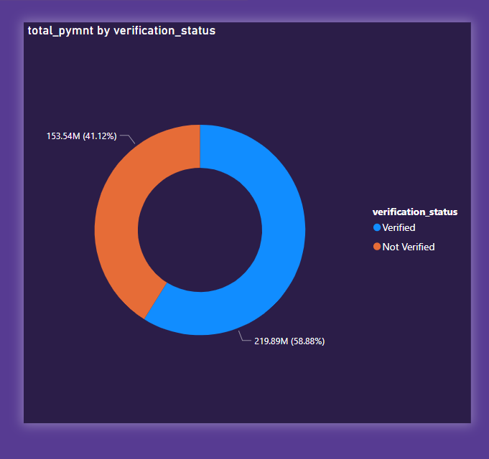
KPI 3 - Total Payment for Verified Status Vs Total Payment for Non Verified Status
ACCORDING TO OUR VERIFICATION STATUS WE HAVE TO CALCULATE OUR TOTAL PAYMENT.
IF OUR LOAN IS APPROVED THEN YOUR VERIFICATION STATUS IS VERIFIED AND IF IT IS NOT APPROVED THEN YOUR VERIFICATION STATUS IS NONVERIFIED.
THE VERIFICATION STATUS IS MORE THAN NON VERIFICATION STATUS BY 66.35 M .

Slide 6
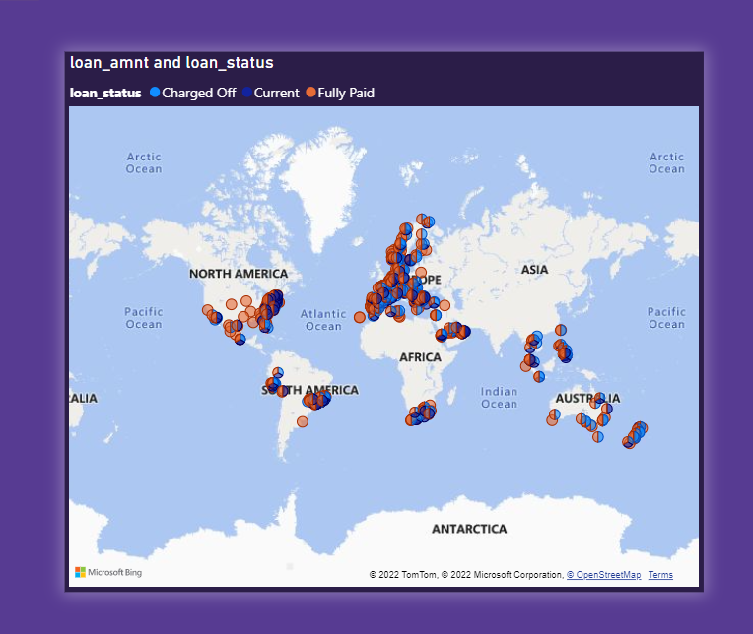
KPI 4 - State wise and last_credit_pull_d wise loan status
IT SHOWS WHICH STATE HAS MAX PAYMENT PENDING AND MADE PAYMENT.
EVEN IT CAN BE COMPARED WHEN WAS LOAN GIVEN AND WHEN THE FULL PAYMENT HAS BEEN MADE THROUGH DATE COMPARING STATES.

Slide 7
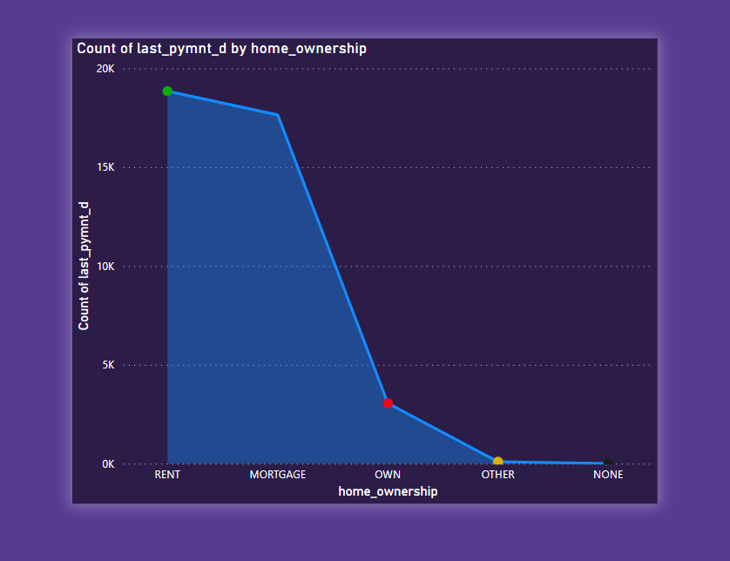
KPI 5 - Home ownership Vs last payment date stats
IT SHOWS HOME OWNERSHIP AND SUB HOME OWNERSHIP VS LAST PAYMENT DATE AND SUM OF LAST PAYMENT AMOUNT
IT SHOWS TENURE OF PAYMENT MADE ACCORDING TO DIFFERENT HOME OWNERSHIP
IN HOME OWNERSHIP RENT VALUE IS MAX. AND OTHER VALUE IS MIN. RENT IS GRETER THAN MORTGAGE BY 15 M . MORTGAGE IS GRETER THAN OWN BY 31 M.AND OWN GRETER THAN OTHER 8M.

Slide 8
THANK YOU

